Slide 1
SQL Task presentation
Naveen J

Slide 2
Business problem
To create a database for attendance portal of a organisation and to perform exercise on the Sql topics given for that the following table are included
Attendance table
Employee detail
Permission detail
Leave detail
Department detail

Slide 3
Topics
Keys
Joins
Subqueries
String functions
Datetime functions
Stored procedures

Slide 4
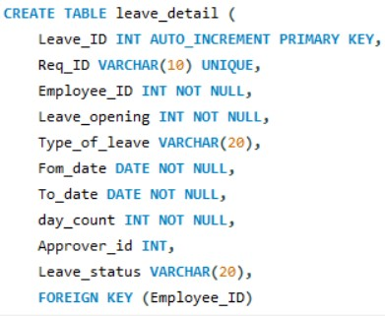
Keys
Keys in sql are the set of attributes that is used to specify the particular column in a table and to find or to create a relation between the tables in a database in this task I have used keys are as follows
Primary Key
Foriegn Key
Unique key

Slide 5
joins
Joins are used to retrieve data from different tables by combining the two or more tables with the help of relation between the tables. There are different types of joins used in sql.
Inner join
Right Join
Left Join
Outer join

Slide 6
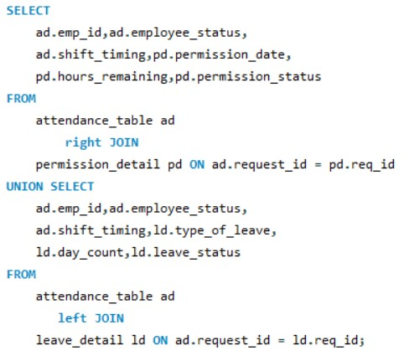
Example
To find the employee who are taken leave or permission in two days and the status of the request.
In this query right join retrieve the common data on request_id and all data on permission_detail.
Then left join fetch the common data on ld.req_id and all data left table and union combine all the data from both query

Slide 7
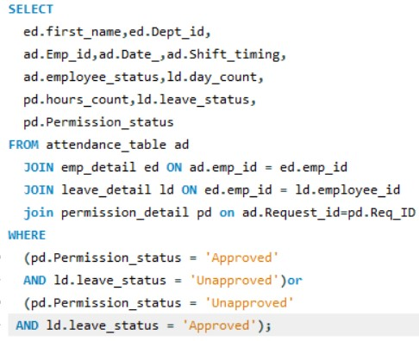
Example
The employee applied both permission and leave on two days and status of the request
In this query combine emp_detail,leave_detail and permission_detail by inner join it returns only common rows between the tables

Slide 8
Subqueries
A subquery is a another sql query that present inside the query. The result of the subquery is used in the main query to obtain result.there are different types of subqueries
Scalar subquery
Multiple row subquery

Slide 9
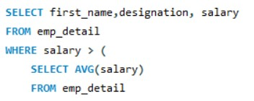
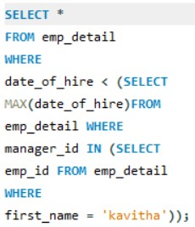
Example
First query is to find the employee detail who has the salary more than the average salary this query is a example for scalar subquery.
Second is to fetch the employee detail who joined the company before the manager kavitha this query is ex for nested query and multiple row subquery.

Slide 10
String functions
String functions in Sql are used to manipulate the string datas in the table .
There are many String functions in SQL from that i have used
Lower,Upper,concat,reverse and substring

Slide 11

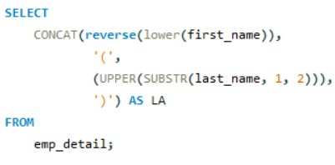
Example
First query to return the first_name and last_name are combined as full name in separate column
Second query return first_name in lower case and reversed then last_name first two letters in uppercase inside the braces

Slide 12
Datetime functions
Datetime in Sql used to manipulate date time data present in the table by changing the date time format,extract particular parameter on the date time column and calculate the difference between two date time datas
Curdate,datediff,day name,month name and timediff are some date time functions used

Slide 13
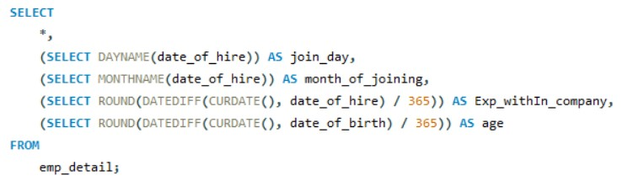
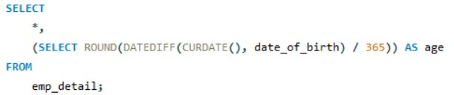
Example
To calculate the employee age,experience with the company and day of joining , month of joining

Slide 14
Procedures
stored procedure is a set of statements that perform some defined actions. We make stored procedures so that we can reuse statements that are used frequently.
Without parameter
With parameter

